Slide 1
ITSC 200 – Network Protocols and Security
Introduction to Crypto

Slide 2
Objectives
To learn more about encryption
To learn about symmetric, asymmetric encryption, and digital signatures
To learn about cryptographic hashing
To learn about common cryptography uses

Slide 3
Cryptography
The term cryptography comes from Greek and literally means secret writing.
Today, cryptography allows us to pursue the ultimate goal of data confidentiality, data integrity, authentication, and non-repudiation.
We have been using cryptography for thousands of years. We know the Romans and Greeks used cyphers.
The Mesopotamians used ciphers as early as 1500 BCE.

Slide 4
Classic Cryptography
Cipher text
53++!305))6*;4826)4+.)4+);806*;48!8`60))85;]8*:+*8!83(88)5*!; 46(;88*96*?;8)*+(;485);5*!2:*+(;4956*2(5*-4)8`8*; 4069285);)6!8)4++;1(+9;48081;8:8+1;48!85;4)485!528806*81(+9;48;(88;4(+?34;48)4+;161;:188;+?;
Plain text
A good glass in the bishop's hostel in the devil's seat forty-one degrees and thirteen minutes northeast and by north main branch seventh limb east side shoot from the left eye of the death's-head a bee line from the tree through the shot fifty feet out.

Slide 5
The Importance of Cryptography
Mary Queen of Scots was executed because a weakly coded message from her to her conspirators was broken by Queen Elizabeth's code breaker.
The decryption of the Zimmerman Telegram brought the US into WW1 in 1917

Slide 6
Classic Cryptography
Near the end of WW1, US Army Major Mauborgne co-invented and introduced the idea of random keys by using two identical pads of paper where each page held a key that was used only once.
It is now called the One Time Pad and even today offers the ”holy grail” of cryptography – perfect secrecy.

Slide 7
One-time pad
Very easy to implement.
Three functions:
Generate Key
Takes an integer n and returns a random n-bit string
Encrypt
Takes a plain text message and encrypts it using the chosen pad
Decrypt
Takes a ciphertext and decrypts it using the chosen pad

Slide 8
One-time pad
We need to encode the message so that it can be represented in binary.
ASCII is one of the most used character encodings to do that.
Each character is encoded using 7 bits (or 8 in Extended ASCII).
Can encode 128 (7 bits) or 256 (8 bits) different characters
All digits, all lowercase and uppercase letters, punctuation …
https://en.wikipedia.org/wiki/ASCII#Printable_characters

Slide 9
Recall: English ↦ Extended ASCII
Hi, sait!

Slide 10
Recall: English ↦ Extended ASCII
H | i | , |  | s | a | i | t | !

Slide 11
Recall: English ↦ Extended ASCII
H | i | , |  | s | a | i | t | !
01001000

Slide 12
Recall: English ↦ Extended ASCII
H | i | , |  | s | a | i | t | !
01001000 | 01101001

Slide 13
Recall: English ↦ Extended ASCII
H | i | , |  | s | a | i | t | !
01001000 | 01101001 | 00101100

Slide 14
Recall: English ↦ Extended ASCII
H | i | , |  | s | a | i | t | !
01001000 | 01101001 | 00101100 | 00100000

Slide 15
Recall: English ↦ Extended ASCII
H | i | , |  | s | a | i | t | !
01001000 | 01101001 | 00101100 | 00100000 | 01110011

Slide 16
Recall: English ↦ Extended ASCII
H | i | , |  | s | a | i | t | !
01001000 | 01101001 | 00101100 | 00100000 | 01110011 | 01100001

Slide 17
Recall: English ↦ Extended ASCII
H | i | , |  | s | a | i | t | !
01001000 | 01101001 | 00101100 | 00100000 | 01110011 | 01100001 | 01101001

Slide 18
Recall: English ↦ Extended ASCII
H | i | , |  | s | a | i | t | !
01001000 | 01101001 | 00101100 | 00100000 | 01110011 | 01100001 | 01101001 | 01110100

Slide 19
Recall: English ↦ Extended ASCII
H | i | , |  | s | a | i | t | !
01001000 | 01101001 | 00101100 | 00100000 | 01110011 | 01100001 | 01101001 | 01110100 | 00100001

Slide 20
Recall: English ↦ Extended ASCII
H | i | , |  | s | a | i | t | !
01001000 | 01101001 | 00101100 | 00100000 | 01110011 | 01100001 | 01101001 | 01110100 | 00100001

Slide 21
Recall: English ↦ Extended ASCII
Hi, sait!
010010000110100100101100001000000111001101100001011010010111010000100001

Slide 22
One-time pad – Generating a pad
Your pad needs to be as long as the message you want to encrypt.
If you need to encrypt a message that is 160 bits in length, your pad needs to have a size of at least 160 bits.
The pad needs to be as random as possible.
Just throw an unloaded coin 160 times and record a 0 for Heads of a 1 for Tails.
You will then share the pad with the person that you want to communicate with.

Slide 23
One-time pad – Encrypting the message
Once the time arrives, you are going to use the pad to encrypt the message.
The encryption mechanism is a simple XOR operation.
If the coin-bit and the message-bit are equal, then store a 0
If the coin-bit and the message-bit are different, then store a 1

Slide 24

0
1
0
1
1
0
0
1
1
0
1
0
1
0
0
1
⊕
0 1 0 0 1 0 1 1
1
1
1
0
0
0
0
1
1
0
1
0
0
0
1
1
0
0
0
1
0
1
1
1

Slide 25
One-time pad – Interactive demo
Visit https://ale.monster/otp for an interactive demo.
1. Convert your message to binary
2. Encrypt the message using a one-time pad
3. Decrypt a cyphertext using a one-time pad

Slide 26
One-time pad – Perfect Secrecy
Perfect Secrecy when used only once.
If an attacker doesn’t know the pad, then the message can become anything.
Message: 0000010100010001000100100000010000001101000011110000000000010101000110110100111000001101000001100001111100011010

Slide 27
One-time pad – Perfect Secrecy
Perfect Secrecy when used only once.
If an attacker doesn’t know the pad, then the message can become anything.
Message: 0000010100010001000100100000010000001101000011110000000000010101000110110100111000001101000001100001111100011010
Pad 1: 0100000101110100011101000110000101100011011010110010000001110100011011110110111001101001011001110110100001110100

Slide 28
One-time pad – Perfect Secrecy
Perfect Secrecy when used only once.
If an attacker doesn’t know the pad, then the message can become anything.
Message: 0000010100010001000100100000010000001101000011110000000000010101000110110100111000001101000001100001111100011010
Pad 2: 0100010001100101011001100110010101101110011001000010000001100001011101000010000001100100011000010111011101101110

Slide 29
One-time pad – BIG Problem!
If the pad is used more than once, an attacker can obtain the pad by guessing words that were transmitted.
Crib-dragging
Known-plaintext attack
Maybe DEMO

Slide 30
Cryptographic Hashes
A cryptographic hash function is a procedure that takes a block of data and returns a fixed-size bit string, the (cryptographic) hash value.
Any change to the data will change the hash value. The data to be encoded is often called the "message," and the hash value is sometimes called the message digest or simply digest.

Slide 31
Cryptographic Hashes
It should be noted that hashes are not really ”encryption” since the original data is not in the hash output.
We should not be able to ”unencrypt” a hash.

Slide 32
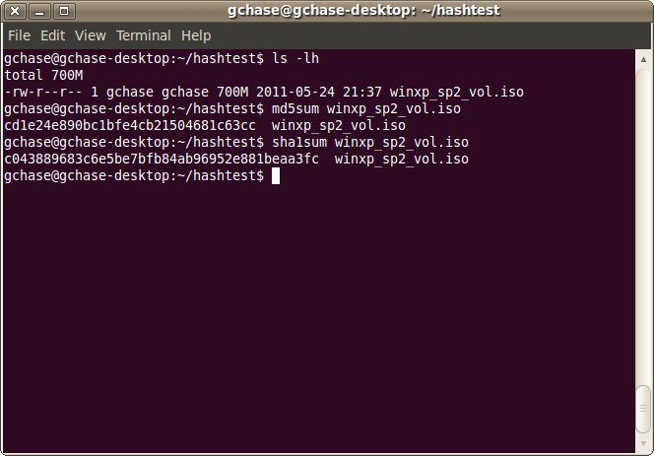
Cryptographic Hashes

Slide 33
Cryptographic Hashes
A good hash function has the following characteristics :
It is easy to compute a hash for any given data
It is not possible to extract the original message from the hash
It is not possible to change the original data without changing the hash output for it.
It is not mathematically feasible to find two different messages with the same hash output (called a ”collision”).

Slide 34
Cryptographic Hashes
Examples of commonly used hashes would be :
MD5 (1996 some flaws were identified)
An NVIDIA GeForce 8800 Ultra can calculate more than 200 million MD5 hashes per second.
An Nvidia RTX 3080 can calculate over 52 billion hashes (with salts) per second. Yes … you read that right … 52 billion per second.
My RTX2060 can calculate a little over 11 billion hashes per second.
SHA-1 (2005 some flaws were identified)
SHA-2 (includes SHA-224, SHA-256, SHA-384, SHA-512)

Slide 35
Cryptographic Hashes
Applications
Storing passwords*
Digital signatures
File integrity
Message authentication codes
Can even be used to quickly look up data in a hash table where the computed hash value becomes the key

Slide 36
Simple MD5 Collision Attack
Setting up the environment:
sudo apt-get install psutils –y
wget https://ale.monster/otp/demos/message1.ps
wget https://ale.monster/otp/demos/message2.ps
Verifying that the files have the same hash:
md5sum message*

Slide 37
Simple MD5 Collision Attack
Print the contents of both files using ps2ascii
ps2ascii message1.ps
ps2ascii message2.ps
Or use ps2pdf to generate a pdf for each file
ps2pdf message1.ps
ps2pdf message2.ps

Slide 38
Another MD5 Collision Attack
wget https://ale.monster/otp/demos/program_1
wget https://ale.monster/otp/demos/program_2
chmod +x program_*
md5sum program_*
./program_1 or ./program_2
Try your luck.

Slide 39

Crypto Break!

Slide 40
Symmetric Encryption
When we think of ”encryption”, this is usually the type of encryption that comes to mind first.
This is a type of encryption that relies on a ”shared secret” between two or more parties that can be used to maintain a private information link.
Digital Encryption Standard (DES) is an example of this type of encryption, but one which is now considered broken … even though it is still widely used.

Slide 41
Symmetric Encryption

Slide 42
Symmetric Encryption
Symmetric-key algorithms can be divided into stream ciphers and block ciphers.
Stream ciphers encrypt the bits of the message one at a time
Block ciphers take a number of bits (often 64 bits) and encrypt them as a single unit.
The Advanced Encryption Standard (AES) algorithm approved by NIST in December 2001 uses 128-bit blocks.
Some examples of popular and well-respected symmetric algorithms include Twofish, Serpent, AES (Rijndael), Blowfish, CAST5, RC4, 3DES, and IDEA.

Slide 43
Symmetric Encryption
Problems
How do I get the key to the other party securely, over an insecure channel ?
This is the problematic ”key distribution” problem
This problem was not solved until the late 20th century
Advantages
Very fast
Secure, if the shared secret (key) is kept secure

Slide 44
Symmetric Encryption using OpenSSL
To encrypt using AES-256:
openssl aes-256-cbc –pbkdf2 -a -e -in plaintext.txt -out ciphered.txt
To decrypt:
openssl aes-256-cbc –pbkdf2 -a -d -in ciphered.txt -out decrypted.txt

Slide 45
Asymmetric Encryption
Not developed until the late 1970's by Ron Rivest, Adi Shamir, and Leonard Adleman
Uses two mathematically related keys
One key is used to encrypt, the other to unencrypt
Knowing one key does not help you to derive the second key
One key is kept private and the second key is published for anyone to use if they wish to send you a secure message.
The keys are generated using very large prime numbers (300 – 400 digits)

Slide 46
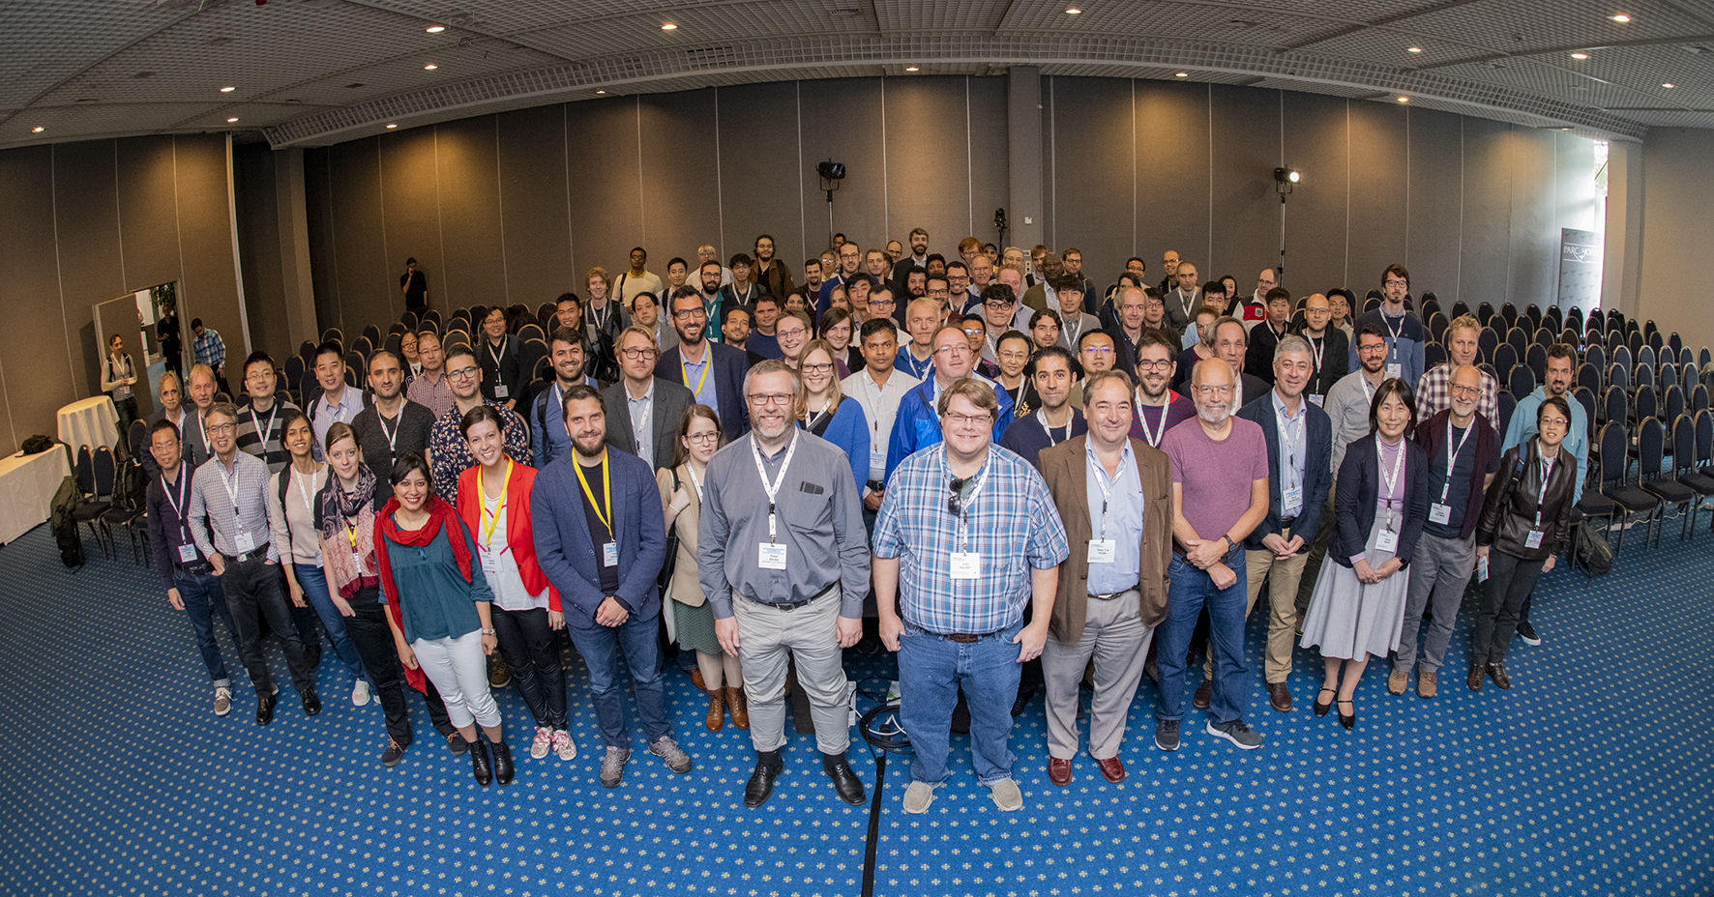

Slide 49
Asymmetric Encryption
While the encryption process is known, recovering the plaintext from the public key is similar to factoring the product of two very large numbers (100’s of digits long).
With large numbers this is considered a MAJOR computational task, even by todays standards, and is believed to be, in terms of time, beyond the capability of any existing technique/computer combination.

Slide 50
Asymmetric Encryption
One major problem left …
Speed … asymmetric is sslowww.
Even computers have a hard time working with numbers this large.

Slide 51
Asymmetric Encryption
Solution
Replace the ”encrypted message” with a symmetric key (shared key)
Continue the communication with symmetric encryption.

Slide 52




Diffie-Hellman Key-Exchange using Rubik’s Cubes
Eve(sdropper)
Alice
Bob

Slide 53
Diffie-Hellman Key-Exchange using Rubik’s Cubes
Protocol:
Alice and Bob publicly combine two sets of cube movements.
G = (center row to the left, middle column to the top, bottom row to the right)
H = (first column to the top, middle column to the bottom, top row to the left)
Each one of them starts with a solved cube
Alice chooses two numbers (a1 and a2)
Bob chooses two numbers (b1 and b2)

Slide 54
Diffie-Hellman Key-Exchange using Rubik’s Cubes
Alice applies the G movements on her cube a1 times
Bob applies the G movements on his cube b1 times
They swap cubes
Bob applies the G movements on his new cube b1 times and the H movements b2 times.
Alice applies the G movements on her new cube a1 times and the H movements a2 times.
They swap cubes again

Slide 55
Diffie-Hellman Key-Exchange using Rubik’s Cubes
Alice applies the H movements on her cube a2 times.
Bob applies the H movements on his cube b2 times.
Now both cubes have the same configuration.
Alice never learned what b2 was.
Bob never learned what a2 was.
The encoding of the cube can be used as a symmetric key!

Slide 56
Asymmetric Encryption
We have now solved the key distribution problem.
If we allow the use of asymmetric encryption to securely pass a symmetric key to another party, we have managed to eliminate the insecure channel for sharing symmetric keys … and because symmetric encryption is fast, we can gain the benefits of symmetric encryption.
Continue the communication with symmetric encryption.

Slide 57
Asymmetric Encryption
Ok, we have secrecy but how do we ensure that the message actually came from the person claiming to send it ?
If the sender includes a hash of the message that is encrypted with their private key, then the entire message is encrypted with the recipient’s public key, we have effectively included a digital signature.
The recipient uses their private key to decrypt the message, then they use the sender’s public key to decrypt the “signature”, if it works it must have been sent by the owner of the public key.

Slide 58
Asymmetric Encryption
So we have solved the secrecy problem (standard symmetric encryption).
We have solved the key distribution problem (asymmetric encryption)
We have solved the non-repudiation problem (check the sender’s digital signature using their public key)
And we have solved the integrity problem by using a secured (encrypted) hash

Slide 59
Generating a Public/Private keypair
ssh-keygen –e –m PKCS8
In Linux, your public and private keys will be stored in ~/.ssh
In Windows they will be stored in %userprofile%/.ssh
id_rsa is the private key
id_rsa.pub is the public key

Slide 60
Creating an extra PEM public-key
ssh-keygen -f ~/.ssh/id_rsa.pub -e -m PKCS8 > ~/.ssh/id_rsa.pem.pub

Slide 61
Using a public key to encrypt a message
openssl rsautl -encrypt -pubin -inkey ~/.ssh/id_rsa.pem.pub -in plaintext.txt -out encrypted.txt

Slide 62
Using a private key to decypt a message
openssl rsautl -decrypt -inkey ~/.ssh/id_rsa -in encrypted.txt -out decrypted.txt

Slide 63
Use your private key to sign a digest
openssl dgst -sha512 -sign ~/.ssh/id_rsa -out digest decrypted.txt

Slide 64
Use the public key to verify a signature
openssl dgst -sha512 -verify ~/.ssh/id_rsa.pem.pub -signature digest decrypted.txt

Slide 65
Attacking Encryption!
Weakness in the algorithm
Cracking the Microsoft LM password (Rainbow Tables, Ophcrack)
http://ophcrack.sourceforge.net
Statistical Attack
WEP (Wired Equivalent Privacy)
Capturing enough encrypted packets (about 10 minutes)

Slide 66
Computers get fast.
Hashcat can use your video card to speed up hashing
hashcat.exe a9a624b3c4d4be9146618bd94beff8e0 -a 3

Slide 67
Applications
The applications of cryptographic hashing, symmetric encryption, and asymmetric encryption are almost endless.
Whenever we use any of the following we are using at least one of the components of cryptography, and usually a combination of them.
Passwords, Secure Shell (SSH), IPSec, SSL, HTTPS, online banking, certificates, digital signatures, Kerberos authentication, and many more

Slide 68
Done

